Slide 1
Derived Data Types

Slide 2
Introduction to Derived Data Types
FORTRAN permits creation of our own data types:
To add new features to the language
Make it easier to solve specific types of problems
A user-defined data type may have:
Any number and combination of components
Each component must be either
An intrinsic data type
Previously defined user-defined data type
User-defined (or Derived) data types must ultimately be derived from intrinsic data types
A derived data type is a convenient way to group all of the information about a particular item.
Derived data type can have many components like an array
The components of a derived data type may have different types.

Slide 3
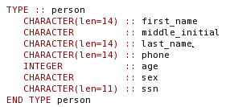

Defining a Derived Data Type
Defined by a sequence of type declaration statements starting with the TYPE statement and ending with the END TYPE statement:
Once the type is defined, variables of that type may be declared:
Each item of a derived data type is known as a structure

Slide 4
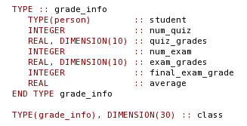
More about Defining Derived Data Types
A derived data type may be used as a component within another derived data type.

Slide 5
Structure Constructor
Derived data type unnamed constants are created using a structure constructor
Consists of the name of the type
followed by the components of the derived data type in parentheses.
Components appear in the order in which they were declared in the definition of the Type:

Slide 6
Working with Derived Data Types
Component can be addressed independently.
Each component can be used just like any other variable of the same type
Components are specified using a component selector:
Component selector consists:
The name of the variable followed by-
A percent sign (%) followed by-
Component name.
Variable
Component

Slide 7
Specifying Derived Data Type Components
A component within an Derived Data Type array can be address:
A component of a derived data type included within another derived data type can be address as follows:
It is not easy working with variables of a derived data type
While assignment of one derived data type variable to another is legal,
Other Intrinsic operations are not defined:
Addition
Subtraction
Multiplication
Division
Comparison
Other intrinsic operations are not straight forward we cover this in chapter 13.

Slide 8
Input and Output of Derived Data Types
When a derived data type is written
By default, each component is written out in the order in which it was declared.
Formatted write statements require Format descriptors to:
Match the type
Order of the components in the variable

Slide 9

Declaring Derived Data Types in Modules
The type definition must be included in every procedure that uses the variable or constants of the derived data type.
Implemented using modules.
Define all derived data types in a program in a single module
Use that module in all procedures needing to use that data type.
The compiler is not required to allocate the elements of the derived variable in successive memory locations.
Built into the Fortran standards to allow compilers on massively parallel computers to optimize memory allocations.
There are times when strict order memory allocations are important.
If the elements must be allocated in consecutive memory locations a special SEQUENCE statement must be included in the type definition.
It is possible to create a function of a derived data type if and only if the function has an explicit interface

Slide 10
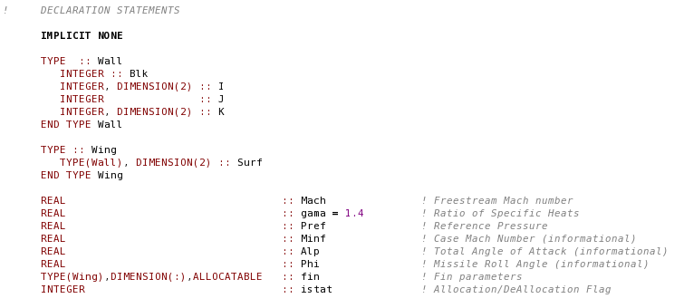
Dynamic Allocation of Derived Data Types
In FORTRAN 2003, an array or variable of a derived data type
Can be declared with the allocatable attribute
Can be dynamically allocated and deallocated

Slide 11

Parameterized Derived Data Types
FORTRAN 2003 allows a user to define a derived data type elements with:
different KIND numbers
different element lengths.
Example: Declare a vector data type with KIND and length parameters
Example data type declaration: Both produce a derived data type containing a three element single-precision vector:

Slide 12
More Examples
Type declaration produces a derived data type containing a 20 element double precision vector
Type declaration produces an array of 100 items of a derived data type, each containing a 20 element double precision vector:
Type declaration creates an allocatable structure whose length is deferred:

Slide 13
Type Extension
In FORTRAN 2003 allows a derived type to be extendable.
May not have SEQUENCE attribute
May not have BIND(C) attribute
BIND(C) makes a FORTRAN 2005 type interoperable with C.
Will not be discuss in this class.
Allows existing user-defined type to be used as the basis of a larger, more comprehensive type definition

Slide 14
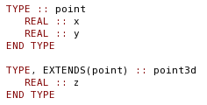
Type Extension Example
New data type contains 3 elements
point is the parent of point3d
Elements x and y defined in type point
Element z unique to type point3d
If we declare a variable, p, as a point3d data type
p will contain 3 components which are addressed as
p%x, p%y, and p%z or
p%parent%x and p%parent%y – This alternative form is used when we want to pass only the inherited values to a procedure

Slide 15
Type-Bound Procedures
FORTRAN 2003 allows procedures to be specifically associated (“bound”) to a derived data type.
Invoked by reference to the derived data type
Type Bound Fortran procedures
Created by adding a CONTAINS statement to the type definition
Declaring the bindings in statement

Slide 16

Type Bound Procedure Example
Declares that a procedure called add is associated or bound type point
If p is a variable of type point, then the add procedure is referenced as p%add(…)
The attribute PASS indicates that the variable p is automatically passed to this procedure as the first calling argument

Slide 17
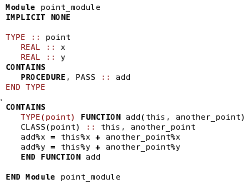
The procedure add must be defined in the same module as the type definition statement.
Derived data types are declared in the bound procedure using the CLASS keyword.
CLASS - Special version of the TYPE keyword (covered in Chapter 16)

Slide 18
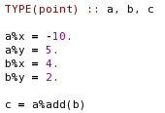
Statement calls function add,
Automatically passes a as the first argument
Passes b as the second argument.
Returns a result of type point and stores it c where c%x = -6 and c%y = 7

Slide 19

PASS vs. NOPASS Attribute
If procedure binding is NOPASS
Variable used to invoke it is not automatically passed
If no attribute is given in the binding, the default attribute is PASS

Slide 20
The ASSOCIATE Construct
FORTRAN 2003, ASSOCIATE construct allows
Temporarily associate a name with a variable or expression during the execution of a code block.
Useful for simplifying multiple references to variables or expressions with long names and/or many subscripts

Slide 21

ASSOCIATE Construct Form:
Where the association_list is a set of one or more associations:
Separated by commas

Slide 22
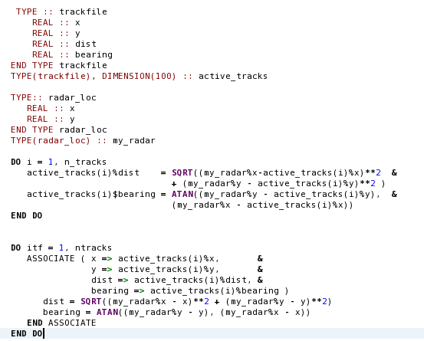
ASSOCIATE Example:

Slide 23
Good Coding Practice
Declare the definitions of derived data types,
In a single module
Use that module in each procedure that needs access to the derived data type
Use the ASSOCIATE construct to simplify multiple references

